Slide 1

MOBILE APPLICATION Development (114155)
Dr. Owais Hussain

Slide 2

Agenda
Agile Methodology
Planning & Communication
Version Control
Issue Tracking
Semantic Versioning
Automated Testing
Documentation
Code Quality control

Slide 3
Sample 2
Agile Methodology
Waterfall model
Bottlenecks and the fall of Waterfall
The perfect Software development methodology –
…and other fairy tales
The philosophy behind Agile methodology
12 Principles of Agile manifesto
https://agilemanifesto.org/principles.html
Notes:
Spiral, Prototype, Extreme Programming, Rapid Application Development, Rational Unified Process, and what not. They all are the same.

Slide 4
Sample 2
Agile Methodology
Our highest priority: customer satisfaction through continuous delivery.
We welcome: changing requirements, even late in development.
We deliver: working software frequently according to customer preference.
Together: we work with customer daily, throughout the project.
Our team: consists of motivated individuals, trusted to do their job.
We prefer: face-to-face communication.
Our KPI: working software.
Why have I skipped the other 5?
Notes:
The remaining 5 principles can only be understood if the defined 7 have been adopted well.

Slide 5
Sample 2
Agile Methodology
Scrum
Discrete timelines (2-4 weeks)
The team has a structure and predefined roles
Software delivered at the end of each scrum
Used mostly by established Software companies
Kanban
Continuous development; software updated after each feature
Roles and processes may change frequently
Too many on-the-fly requests/changes
One board, everyone onboard
Used mostly by students/hobbyists
Lean
Used to develop MVP
Build nothing but what’s absolutely necessary
Automate and continuously improve
Used by Start-ups

Slide 6
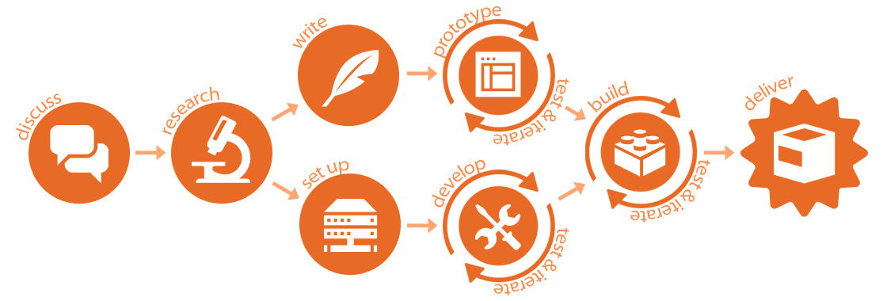
Sample 2
Agile Methodology
Inside a modern software house…

Slide 7
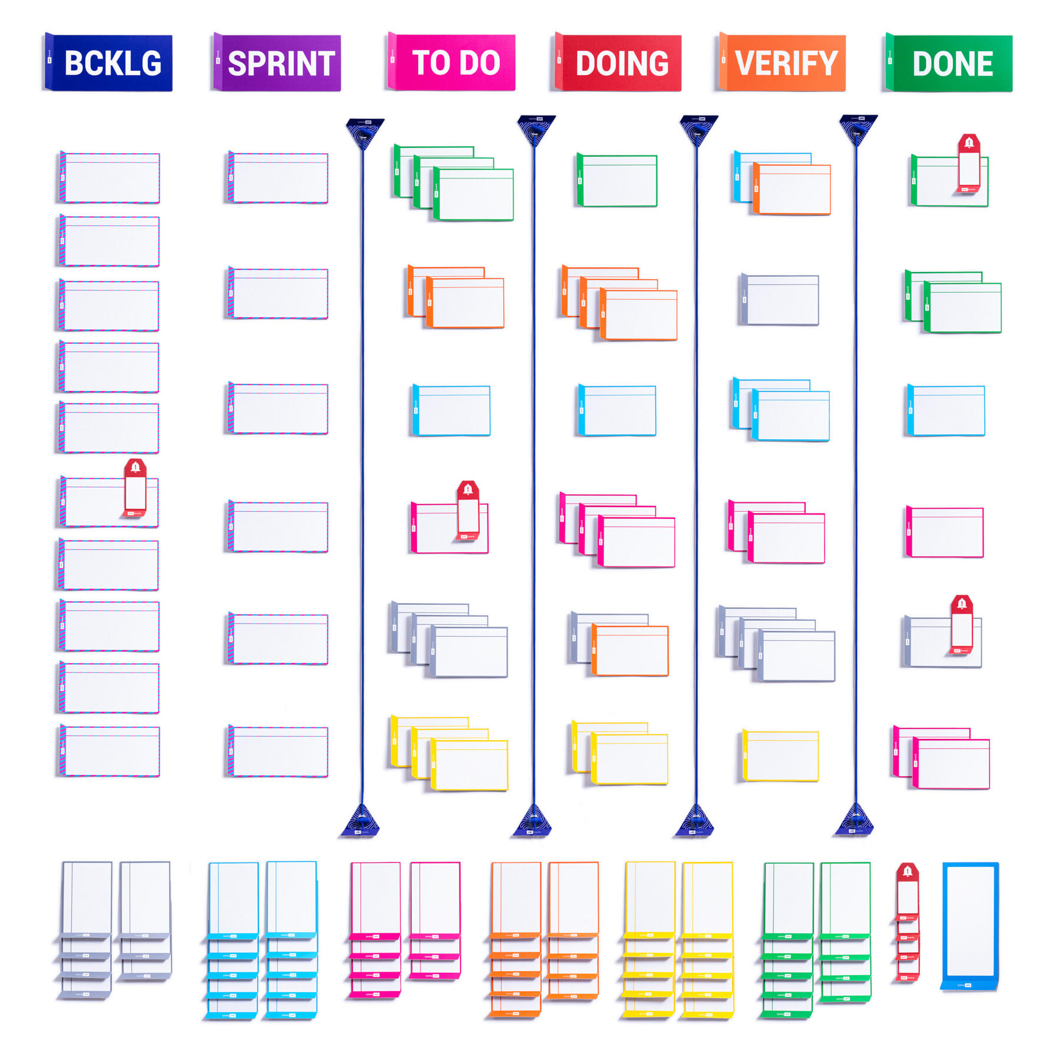
Sample 2
Planning and Communication
Planning is good. Plans are bad.
Jira, Trello, Asana, Hardboard.
Formal communication
Email, Hard documents, Review meetings, Wiki
Informal communication
Stand-ups, Slack/MS Team, Huddles, Coffee breaks
Notes:
Continuous planning is needed because:
What works for me may not work for you
What works for me may not work for me in another project
What works for me today may not work for me tomorrow in the same project

Slide 8
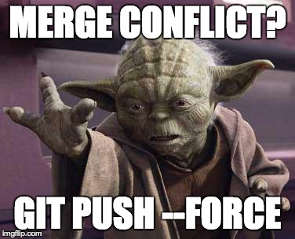
Sample 2
Version Control
Version control systems allow us to manage changes to code and preserve all the revisions.
Git vs Subversion/MS Source Safe/MS Team Foundation Server/Mercurial
Github: what it is, and what it isn’t
Single repository per app (app, not project)
Github flow: feature branches and protected branches
Code reviews and mergers
Handling conflicts
Notes:
Github isn’t flash drive. It isn’t supposed to back up stuff, repos shouldn’t be made and deleted life selfies.

Slide 9
Sample 2
Issue Tracking
Issue can be a bug, a feature request or change request.
Common Protocol:
Discussion > Email > Update documents > Jira > Sprint planning
Impact analysis, priority, activity type, estimates and progress update
In target sprint > Design > Build > Test > Deliver > Verify
Do not always come from clients.
Feedback collection – a preemptive step to avoid defects.

Slide 10
Sample 2
Semantic Versioning (SemVer)
Versioning is assigning unique names/numbers to software builds.
Each app has separate versioning.
Major: Architecture-level change
Minor: Backwards incompatible change
Micro/Maintenance: Backwards compatible change

Slide 11
Sample 2
Semantic Versioning (SemVer)
Releases:
Pre-alpha Release: not exactly released
Alpha Release: in-house testing
Beta Release: external testing (clients)
Production Release: no known bugs
Tagging on Github

Slide 12
Sample 2
Automated Testing
Ensures that each feature is manually tested only once.
Unit Testing:
Junit, PyTest, Django Tests
API Testing:
Postman, Insomnia
Performance Testing:
Apache JMeter, Selenium
UI Testing:
Browser DevTools

Slide 13
Sample 2
Documentation
Rules:
Zero documentation is recipe for failure.
Documenting everything is waste of time
Write-only documentation is waste of time
Static documentation is waste of time
Shakespearean language is waste of time
Levels:
For everyone: Wiki
For internal team: Jira
For Engineers: in-code
For clients: MS Office/Google drive

Slide 14
Sample 2
Code Quality control
Code Quality check:
Eliminates bad practices
Increases readability
Prevents security holes
Increases runtime performance
Why? Because of weak understanding of:
Design patterns
OOP concepts
Data structures
Querying
Test-driven development
Code Reviews
Linting
Dedicated tools (e.g., SonarQube)

Slide 15
Sample 2
In a nut-shell
Client asks a feature on email
Business analyst performs analysis, and the feature is approved
Client creates a ticket on Jira
Scrum master picks the ticket and converts into a user story
User story is converted into tasks and put on backlog on scrum board
Tasks are picked in sprint planning meeting
Designer provides mockup/wireframe
Developers write code, perform unit testing and linting, and commit on local branch
Lead programmer reviews code and merges into master branch
The code is built and artifacts are created
Artifacts are deployed automatically on test environment
Quality Assurance team performs testing and approves the build
Build is deployed and validated to production environment a day before end of sprint
Release notes are prepared, and respective tasks are closed

Slide 16
THANK YOU
Owais Hussain
+92 345-3174270
owais.hussain@kiet.edu.pk
https://www.researchgate.net/profile/Owais-Hussain-3

